Slide 1
Predicting Melbourne Housing Prices
Morten Frederiksen

Slide 2
Problem statement and data
Housing prices have risen the last decade or more, and opacity exists in how prices of housing are determined.
Can one therefore use housing data to confidently predict housing prices using machine learning models?
Using data sourced from Kaggle ( https://www.kaggle.com/anthonypino/melbourne-housing-market ), we try to estimate the price of housing in Melbourne.

Slide 3
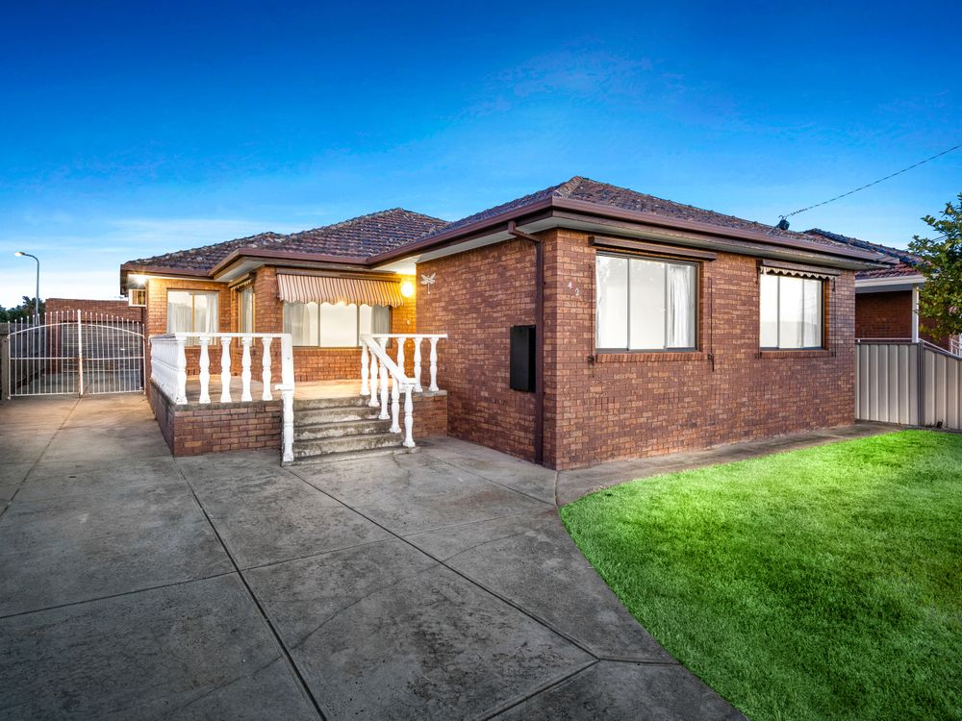
Can we predict the price of this home?
https://www.realestate.com.au/property-house-vic-thomastown-133575746
3 bedroom, 2 bathroom, ~1985 built, 15km from CBD

Slide 4
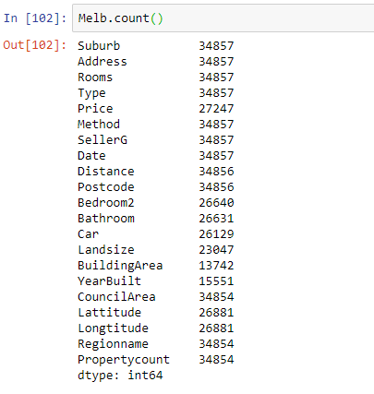
What data do we have?

Slide 5
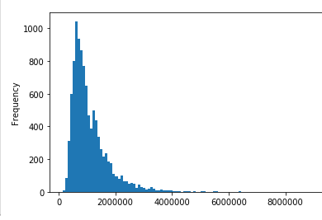
What does housing price data look like?

Slide 6
Initial data exploration and cleaning
34,857 rows
Dataset was reduced to eliminate key missing values.
Dataset was cleaned and predictive variables analysed as inputs into the model.
Outliers were analysed and edited if appropriate, removed if needed.
10,184 rows

Slide 7
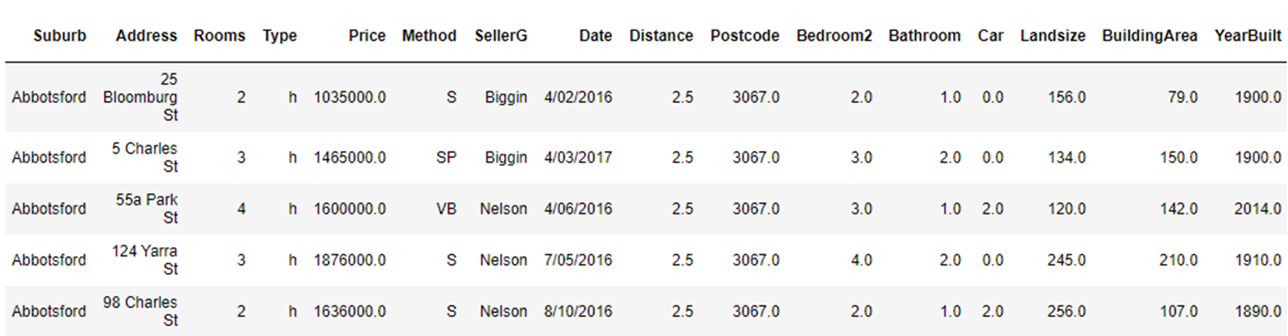
Dataset consisting of 10,184 sales prices and property information.
A total of 213,864 datapoints

Slide 8
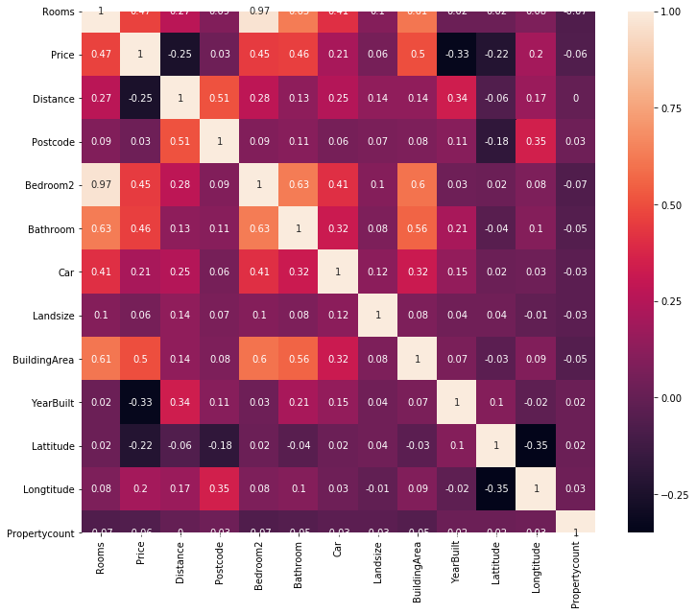
Choosing initial variables for linear model
More highly correlated variables with pricing were:
Rooms (number of rooms)
Bathrooms (number of bathrooms)
Bedroom2 (number of bedrooms)
Building Area (size of property)
Year Built (age of property)
Distance (distance from city centre)
Variables with high multi-collinearity (Rooms and Bedroom2) were eliminated to only include stronger variable.

Slide 9
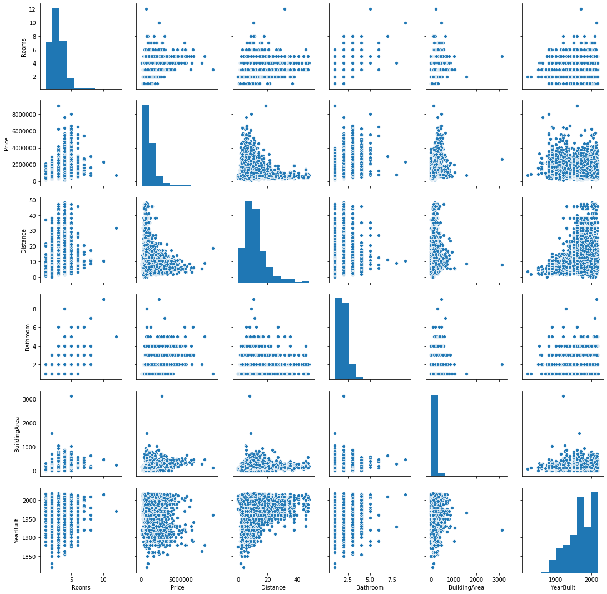
Analysing the key predictive variables

Slide 10
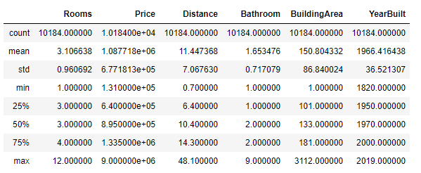
Data insights
Varying degrees of dispersion of the data exists across the different variables.

Slide 11
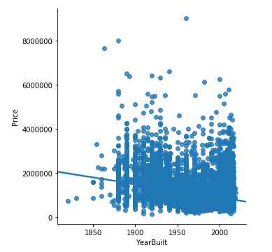
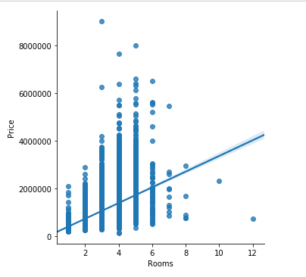
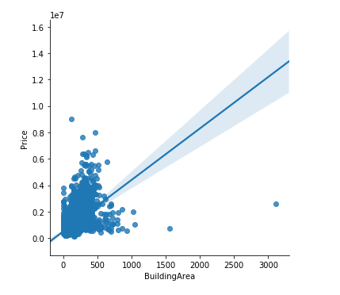
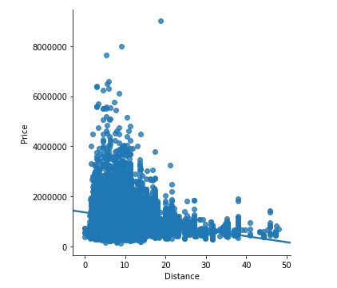
Initiating a predictive model
Using data science and machine learning approaches, a model is developed to predict housing prices based on some statistically relevant metrics.
Determining metrics are:
No of rooms
Building area
No of bathrooms
The year the property was built
Distance from city centre.

Slide 12
Linear Regression
Linear model using factors to determine pricing:
Price = 11696155.876 + 138246.982 (Rooms) – 5850.721 (YearBuilt) + 2322.16 (BuildingArea) + 250434.13 (Bathroom) – 25966.29 (Distance)
Example: (3 Rooms, 1985 build, 150m2, 2 bathrooms, 15km from city):
Price = $ 956,913.06

Slide 13
Accuracy of linear model
R2 of 0.53489
Indicates ~0.46 error rate (almost 1 in 2) in predicting housing prices correctly.
While a reasonable model fit, it is not optimal and we need to see if we can improve on the accuracy.
Can we tweak variables and the model to obtain higher accuracy??

Slide 14
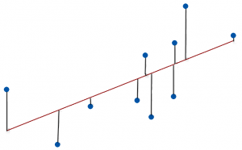
How does the metric work?
R-Squared is a statistical measure of fit that indicates how much variation of a dependent variable is explained by the independent variable(s) in a regression model.
A goodness of fit

Slide 15
Machine Learning Approach
Build a model
Determine variables
Build a network of models
Establish most appropriate model
Tune the model
To establish optimal accuracy
Result

Slide 16
Model tuning
Standardizing features of the model to reduce scale distortions.
Fitting of the model.
Testing sample of the data to ensure consistency.
Cross-validation of features to ensure optimal weighting.

Slide 17
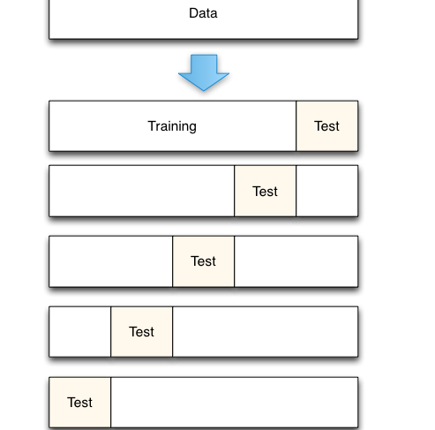
Testing and training the model

Slide 18
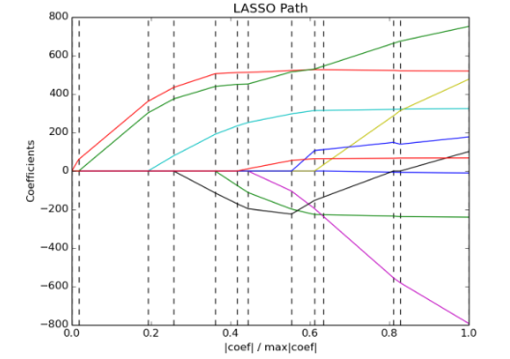
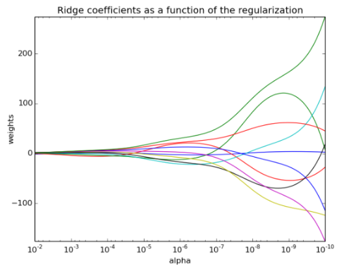
Adjusting the variables

Slide 19
Results
 | Predictive accuracy (R2) | Example prediction
Linear model | 0.535 | $956,913
Testing model | 0.564 | $956,350
Lasso regression | 0.528 | $943,316
Ridge regression | 0.535 | $1,086,921
ElasticNet regression | 0.514 | $923,109
Cross-validation | 0.53 | $958,059
Support Vector Regression | -0.008 | $894,859

Slide 20
Optimal model
Optimal model using factors to determine pricing:
Price = 11602355.46 + 139888.347 (Rooms) – 5799.44 (YearBuilt) + 2106.37 (BuildingArea) + 257825.923 (Bathroom) – 25692.533 (Distance)
Example: (3 Rooms, 1985 build, 150m2, 2 bathrooms, 15km from city):
Price = $ 956,350.72
0.44 error rate

Slide 21
Conclusion
Predicting Melbourne housing prices using the available variables has limited predictive ability.
We can predict the housing price only with 56% confidence/accuracy.
Machine learning approaches were not able to improve the accuracy much of the initial linear model.
Hence we cannot confidently conclude that the variables used at this juncture are sufficient to be able to confidently predict housing prices with a high degree of accuracy.

Slide 22
Future /next steps
Further expand the dataset to include more up-to-date data, over a longer time period, using web-scraping.
Narrow focus to individual council areas to see if more predictive accuracy in certain councils or areas.
Break down certain other variables (housing type, sales method, etc) to establish whether they could hold predictive ability.
Explore other, similar datasets in other geographies, to see if other variables could become relevant.
Expand the variable set to establish whether other variables could have predictive powers.

Slide 23
What are the other ways to predict prices?
Use a classification model to attempt to predict a home price in a range of $10k, $25K or $50K band.

